Slide 1
Morphology1 (2)

Slide 2
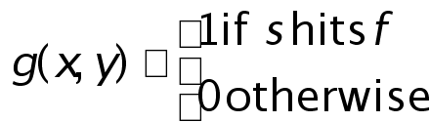

Dilation
Dilation of image f by structuring element s is given by f s
The structuring element s is positioned with its origin at (x, y) and the new pixel value is determined using the rule:

Slide 3
Dilation
The dilation process the structuring element is reflected and shifted from left to right and from
top to bottom, at each shift;
the process will look for any overlapping similar pixels between the structuring element and that of the binary image.
If there exists an overlapping then the pixels under the centre position of the structuring element will be turned to 1 or black.

Slide 4
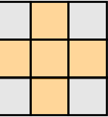
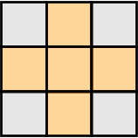
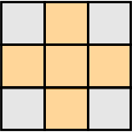
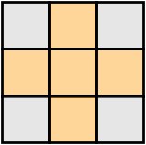
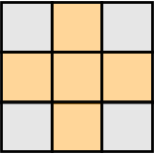
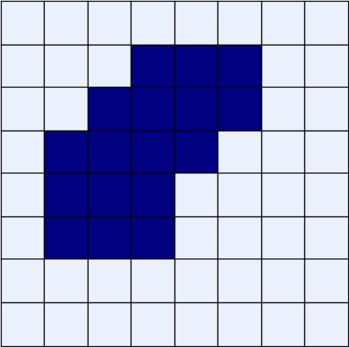

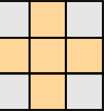
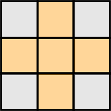
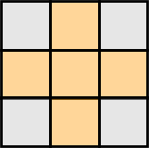
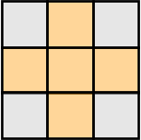
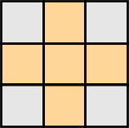

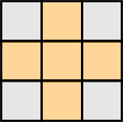
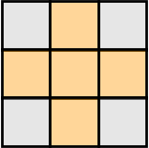
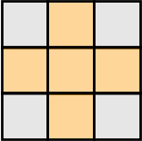
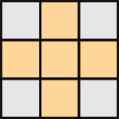
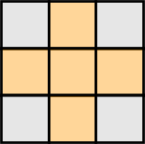

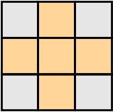
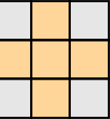
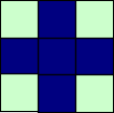
Dilation Example
Original Image
Processed Image
Structuring Element

Slide 5
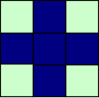
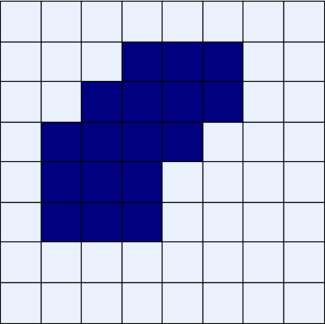






















Dilation Example
Original Image
Processed Image With Dilated Pixels
Structuring Element

Slide 6

Dilation Example 1
Original image
Dilation by 3*3 square structuring element
Dilation by 5*5 square structuring element
Watch out: In these examples a 1 refers to a black pixel!

Slide 7
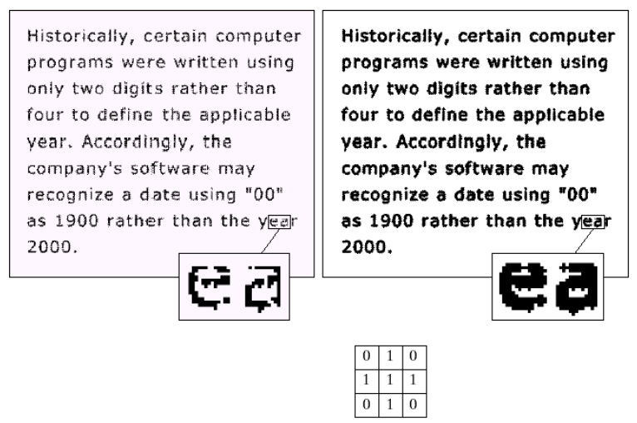
Dilation Example 2
Original image
After dilation
Images taken from Gonzalez & Woods, Digital Image Processing (2002)
Structuring element

Slide 8


What Is Dilation For?
Dilation can repair breaks
Dilation can repair intrusions
Watch out: Dilation enlarges objects

Slide 9
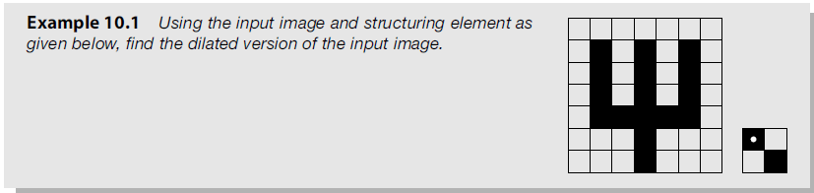

Slide 10
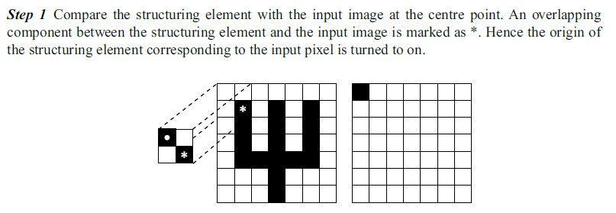

Slide 11
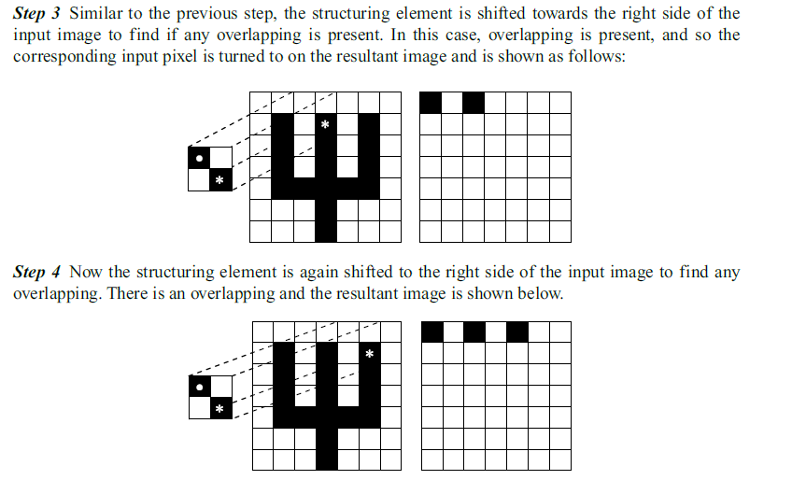

Slide 12
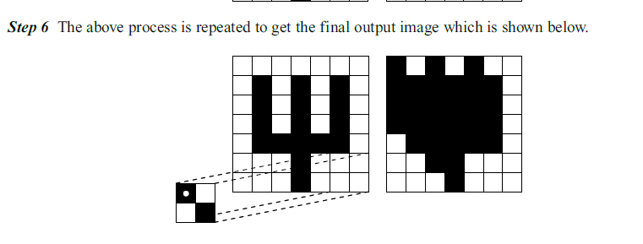

Slide 13
Erosion
Erosion is the counter-process of dilation. If dilation enlarges an image then erosion shrinks the image.
The process will look for whether there is a complete overlap with the structuring element or not.
If there is no complete overlapping then the centre pixel indicated by the centre of the structuring element will be set white or 0

Slide 14
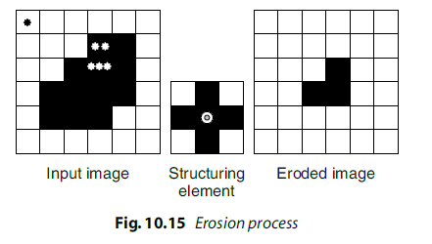

Slide 15
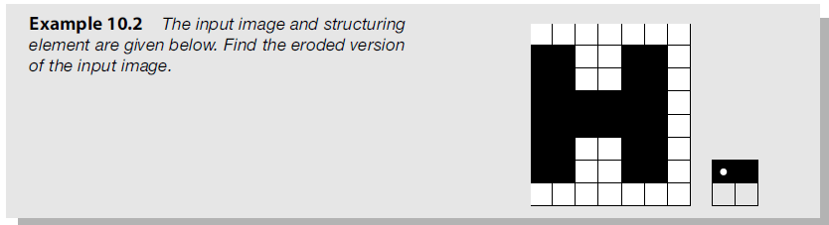

Slide 16
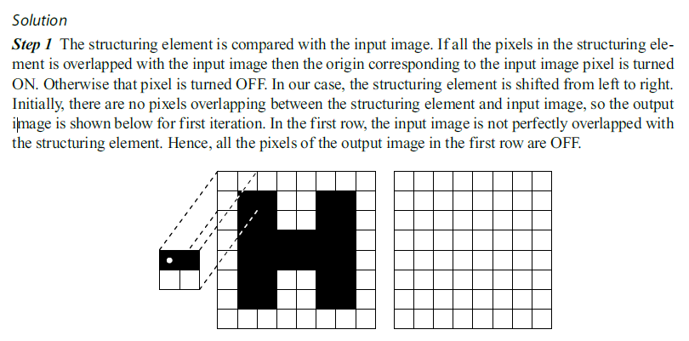

Slide 17
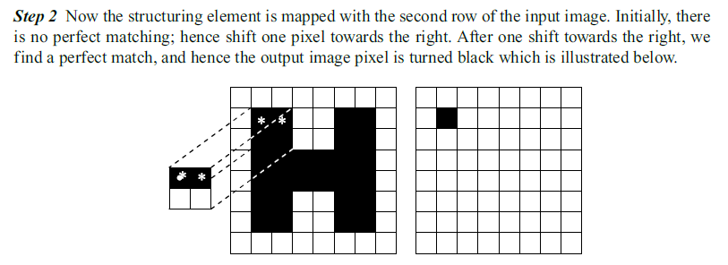

Slide 18
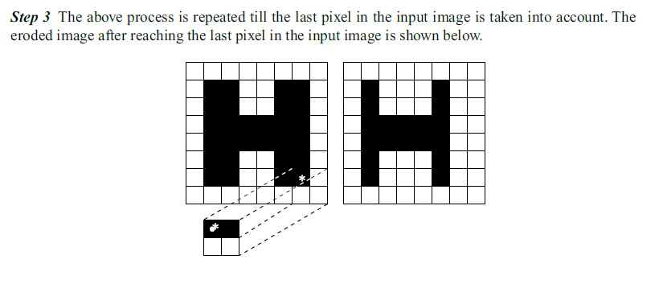

Slide 19
Compound Operations
More interesting morphological operations can be performed by performing combinations of erosions and dilations
The most widely used of these compound operations are:
  Opening
  Closing

Slide 20
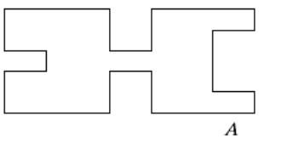
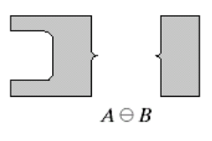
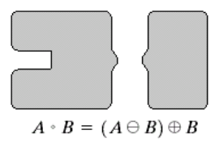
Opening
The opening of image f by structuring element s, denoted f ○ s is simply an erosion followed by a dilation
f ○ s = (f s) s
Images taken from Gonzalez & Woods, Digital Image Processing (2002)
Original shape
After erosion
After dilation
(opening)
Note a disc shaped structuring element is used

Slide 21


Opening Example
Original Image
Images taken from Gonzalez & Woods, Digital Image Processing (2002)
Image After Opening

Slide 22
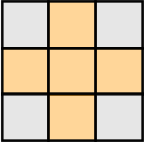
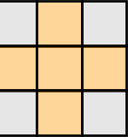
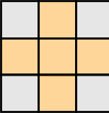



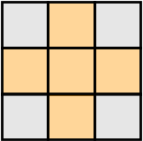
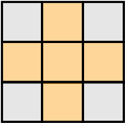
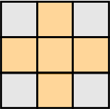
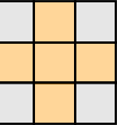








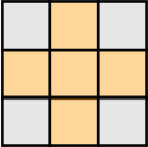
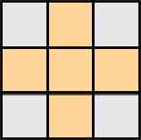
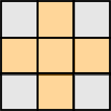
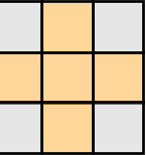
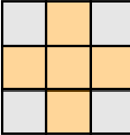




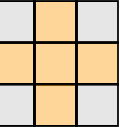
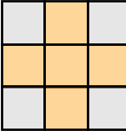
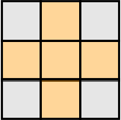

Opening Example
Original Image
Processed Image
Structuring Element

Slide 23










Opening Example
Original Image
Processed Image
Structuring Element

Slide 24



Closing
The closing of image f by structuring element s, denoted f • s is simply a dilation followed by an erosion
f • s = (f s)s
Images taken from Gonzalez & Woods, Digital Image Processing (2002)
Original shape
After dilation
After erosion
(closing)
Note a disc shaped structuring element is used

Slide 25

Closing Example
Original Image
Images taken from Gonzalez & Woods, Digital Image Processing (2002)
Image After Closing

Slide 26













Closing Example
Original Image
Processed Image
Structuring Element

Slide 27

Closing Example
Original Image
Processed Image
Structuring Element

Slide 28

Morphological Processing Example
Images taken from Gonzalez & Woods, Digital Image Processing (2002)

Slide 29
Morphological Algorithms
Using the simple technique we have looked at so far we can begin to consider some more interesting morphological algorithms
We will look at:
  Boundary extraction
  Region filling
  Extraction of connected components
  Thinning/thickening
  Skeletonization
  Convex Hull
  Pruning

Slide 30
Hit and Miss Transform
The hit-or-miss transform is a transformation which is used for template matching.
The transformation involves two template sets, B and (W−B), which are disjoint.
Template B is used to match the foreground image, while (W−B) is used to match the background of the image.
The hit-or-miss transformation is the intersection of the erosion of the foreground with B and the erosion of the background with (W−B).

Slide 31


Slide 32


Slide 33


Slide 34


